Slide 1
Accessibility Principles for Instructional Designers
Victoria Reece Wilson

Slide 2
Objectives
Explain basic design considerations for creating accessible documents
Create, edit, and test accessible Microsoft® Office files
Create, edit, and test accessible .pdf files
Use JAWS ® software to test file accessibility

Slide 3
Course Overview
Lesson 1: Accessibility Fundamentals
Lesson 2: Microsoft® Office Accessibility
Lesson 3: Adobe® Acrobat Accessibility
Lesson 4: Testing with JAWS®
Lesson 5: Capstone Exercise

Slide 4
Accessibility Fundamentals
Lesson ONE

Slide 5
What You Will Learn
Describe the types of disabilities that require assistive technologies to read digital documents
Identify types of assistive technologies for reading digital documents
Explain basic design considerations for creating accessible documents for each disability type
Describe U.S. Accessibility laws as they apply to Instructional Design

Slide 6
Why is Accessibility Important?
Nearly 1 in 5 people in the U.S. have a disability of some kind¹
Permanent disabilities
Temporary disabilities
Age-related disabilities
¹https://www.census.gov/newsroom/releases/archives/miscellaneous/cb12-134.html
Notes:
Content accessibility isn’t something that only applies to a small percentage of the population. A wide range of disabilities exist that require some form of accommodation. For some people, disability is temporary: perhaps the result of injury. For others, their disability is something they’ve had since birth. Others are experiencing a decline in physical ability as they age. In fact, nearly 1 in 5 people in the U.S. have a disability of some kind.
In this age of information, it is necessary that we make materials accessible to everyone to ensure we’re not excluding a large population from our content.

Slide 7
Why Learn About Disabilities?
Understanding Shapes Practice
Knowing the types of disabilities and the needs of each will change the way you think about creating content and testing for accessibility
Notes:
So why begin reviewing disability types rather than diving directly in to checking documents for 508-compliance?
Often, file accessibility requires problem solving skills when solutions are not immediately clear. Having a solid understanding of accessibility needs helps guide the decisions you make when making these materials compliant.

Slide 8
Disability Types
Notes:
Let’s begin by reviewing a few common types of disabilities that require accommodation in accessing digital content.

Slide 9
Types of Disabilities
Visual
Auditory
Motor
Cognitive
Seizure
Notes:
Five types of disabilities commonly considered when discussing digital content accessibility:
Visual
Auditory
Motor
Cognitive
Seizure

Slide 10
Visual Disabilities
Visual
Blindness
Low Vision
Color-blindness

Slide 11
Auditory Disabilities
Auditory
Deafness
Other Hearing Loss

Slide 12
Motor Disabilities
Motor
Traumatic Injury
Diseases
Congenital Conditions

Slide 13
Other Disabilities
Cognitive
Seizure
Attention
Comprehension
Photoepilepsy
Problem-Solving
Memory
Notes:
Two additional disability types considered are cognitive and seizure disabilities. This course won’t be going into further detail on these disabilities, but it’s important to be aware of their needs when creating digital content.
Cognitive Disabilities:
Cognitive disabilities can affect
Attention
Problem-solving
Comprehension
Memory
While it’s often not possible to add address all of these issues in every piece of digital content, these issues underline why clarity and conciseness is always important when drafting and organizing instructional content.
Seizure:
In some cases, strobe effects and flickering/flashing lights can trigger seizures for some viewers. According to the Web Content Accessibility Guidelines (WCAG), three flashes per second constitutes a “strobe effect” and should be avoided in digital content.

Slide 14
Assistive Technologies
Notes:
Assistive technologies can greatly help deliver information to users with disabilities. Unfortunately, all of these technologies have limitations.
Content must be designed with accessibility in mind and with an understanding of existing assistive technologies in order to ensure that information will be conveyed effectively.

Slide 15
Screen Readers

Slide 16
Alternative Keyboards
Adaptive Keyboards
One-Handed Keyboard

Slide 17
Other Input Technologies
Mouth Stick
Head Wand
Sip and Puff Devices
Eye Tracking Devices
Speech Recognition Software
Notes:
In exploring all of the types of input technologies available to users with mobility limitations, one thing should be obvious: not all users are able to use a mouse to navigate content on screen. Content designers must ensure that those using alternative input methods can effectively “reach” all content, and that navigation is not interrupted or complicated by incorrect reading order.
Additionally, not many technologies exist for users with auditory disabilities. It’s up to content designers ensure that the needs of these users are met by the inclusion of transcripts and captioning when appropriate.

Slide 18
Best Design Practices
Notes:
The following slides will provide a high-level review of how content designers can work WITH assistive technologies to make content accessible from the start. These best design practices can be generally carried over into all types of content creation. More specifics on how these ideas can be implemented in different types of software will follow in later lessons.

Slide 19
Alternate Text
Notes:
Alternate text is a text-based representation of shapes and images included in your document. It allows a non-sighted user to hear a detailed description of a graphic.

Slide 20
Alternate Text
This graph compares the average male and female U.S. salary across two different years.
2010 – The average U.S. female salary was $34,700. The average U.S. male salary was $42,800.
2012 -The average U.S. female salary was $37,791. The average U.S. male salary was $49,398.

Slide 21
Alternate Text
How would you describe THIS?
Notes:
Sometimes you have to reach out to your Subject Matter Experts.
“A map sketch is provided centered on the location of the Chernobyl plant accident site on the Northern Ukrainian border with the southern border of Belarus. The border with Russia is shown further toward the northeast. Overlain on the map is an irregularly shaped pattern illustrating concentration gradients for deposits of Cesium-137. The locations of the deposits reflect changes in prevailing wind directions over the course of the primary release period. One region of deposition is shown to be largely distributed in a one-hundred mile-wide swath extending to the west of the facility for hundreds of miles as far west as eastern France while the other extends into Belarus, the western border of Russia and beyond into Sweden, Finland, Norway and the Norwegian and Barents Sea. Belarus, to the north of the plant, exhibits the highest average contamination concentration in a swath approximately two-hundred miles long and one-hundred miles wide.
Within each of these regions, Cesium-137 deposition is separated into four concentration gradients using a color-coded legend. The transition levels for these gradients, from lowest to highest concentration, and the level of control associated with each, are as follows:
One to fifteen micro-curies per square meter – “Un-named Zone”: This represents the dominant concentration across the entire region and the map depicts “islands” of such regions well beyond the contiguous areas of deposition.
Five to fifteen micro-curies per square meter – “Periodic Control Zone”: These areas appear to represent about forty-five percent of the affected region in both the west and northern swathes and form fairly contiguous clusters nearer the central areas of the individual deposition swathes.
Fifteen to forty micro-curies per square meter – “Permanent Control Zone”: As might be expected, these areas are contained within the periodic control zone regions and constitute approximately fifty percent of the area in both the west and northern swathes.
Greater than forty micro-curies per square meter – “Confiscated/Closed Zone”: Such ‘hot-spots’ constitute nearly fifty-percent of the permanent control zone areas in both the west and northern swathes.”
Again, it’s good to be aware of complex needs early, to accommodate project scheduling.

Slide 22
Color Contrast
The quick brown fox jumps over the
LAZY DOG
The quick brown fox jumps over the
LAZY DOG
Notes:
Color contrast checkers can be used to determine if sufficient color contrast is being used.
One example: http://webaim.org/resources/contrastchecker/

Slide 23
Text Size and Resolution
Notes:
Text size can typically be easily enlarged if needed. Text that can’t be enlarged is text that has been saved as an image file. Even if adequate alt text is provided, this can cause difficulties for users with low vision. “Live” text should be used whenever possible.

Slide 24
Captioning and Transcripts
Notes:
This is an example of a transcript.

Slide 25
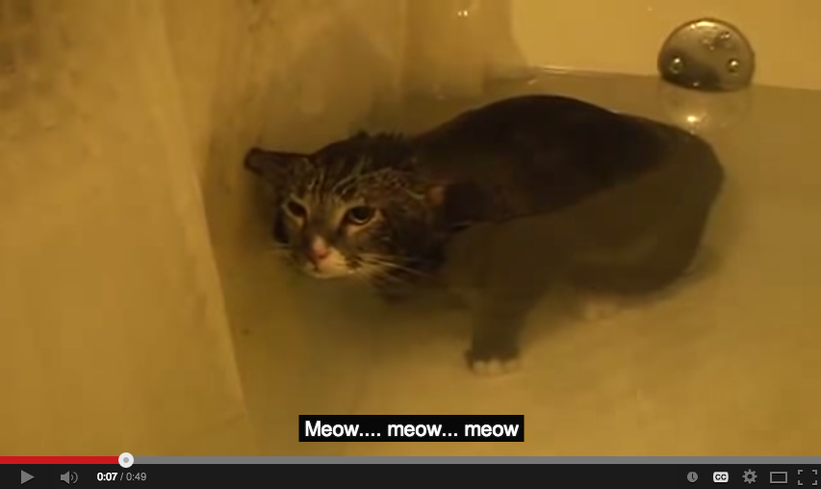
Captioning and Transcripts
Notes:
This is an example of a caption.

Slide 26
Headings and Styles
Notes:
In addition, heading levels should never be “skipped”. For example, a heading level 3 should never come directly after a heading level 1.

Slide 27
Conveying Meaning

Slide 28
Using Appropriate Language
Words to Avoid: | Use Instead:
Click | Select Navigate
Look See View | Observe Notice
Shown | Displayed Illustrated

Slide 29
Accessibility Laws

Slide 30
U.S. Accessibility Laws
The Americans with Disabilities Act (ADA)
Section 508 of the Rehabilitation Act
21st Century Communications and Video Accessibility Act (CVAA)

Slide 31
§508 and Instructional Design
Section 508 requires the Federal government to take accessibility into account when procuring information technologies.

Slide 32
Conclusion
Notes:
So now that we’ve briefly explored the law and better understand various accessibility needs, where do we begin in terms of making our work accessible?

Slide 33
Accessibility and The ISD Process
Analysis
What are the accessibility considerations for the selected medium of instruction?
Will my classroom require any special accommodations?
Implementation
Evaluation
Design
I think I’ll need a Subject Matter Expert to help me describe this map.
Development
Will this content require any complex charts or graphs?
Notes:
Accessibility considerations should be made during every stage of the process. Take, for example, the ADDIE process as depicted on this slide. There are questions that you as the designer should be asking yourself throughout the entire cycle.

Slide 34
Additional Resources
Section508.gov
hhs.gov/web/508
WebAIM.org
w3.org/WAI/intro/wcag

Slide 35
Microsoft® Office Accessibility
Lesson TWO

Slide 36
What You Will Learn
Create accessible Microsoft® Office files
Edit existing Microsoft® Office files to improve their accessibility
Test the accessibility of Microsoft® Office files

Slide 37
Accessibility Starts at the Source
Incorrect Assumption:
Word files don’t need to be§508-compliant
Notes:
As we’ve already discussed, accessibility needs to be in the back of your mind during every step of the ISD cycle to ensure a fully-accessible final product. Even if Office files are only serving as source files and are not being delivered to the client, accessibility still must be considered at this level. This is because many basic accessibility modifications transfer through the .pdf conversion process, allowing for reduced work in the finalization of the document (and also the elimination of duplicated efforts should the source file require revision).
We’ll be focusing mainly on Word in the following slides, but the majority of these techniques are performed similarly across Office products.

Slide 38
Basic Design Considerations

Slide 39
Basic Design Considerations
Alt Text
Headings and Styles
Color Contrast
Text Size/Resolution
Reading Order
Text Formatting
Tables
Lists
Hyperlinks

Slide 40
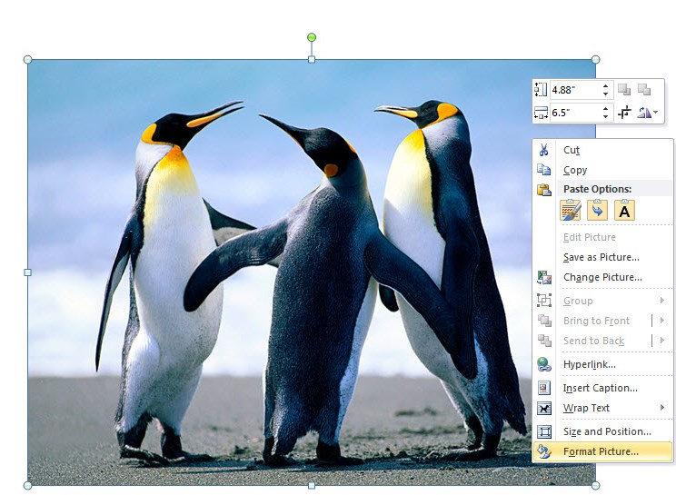
Alternate Text

Slide 41
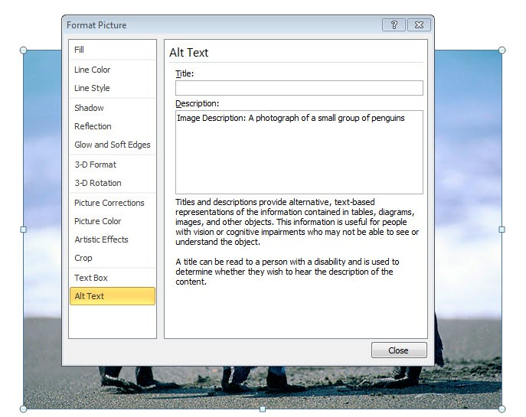
Alternate Text
Notes:
Note: Word 2010 is “smart” enough to know that filenames that make their way into alt text don’t really constitute alt text. You don’t have to worry about forgetting to input alt text, and having it pass the accessibility check due to filename data.

Slide 42
Alternate Text
Shapes and SmartArt
Environment
Ability
Technology
Human Capability

Slide 43
Reading Order
The following can cause problems for screen readers:
Text Boxes
“Floating” elements
WordArt
Make sure you need them before using them.

Slide 44
Headings and Styles
Notes:
Create strong document structure by using headings from the styles panel. When you use formatting techniques such as bold and font size increase to convey section headers, your document has no structure. A screen reader will not be able to interpret what text designates a header or new section, making navigation more difficult.
Accessibility aside, if you do not use heading styles, you will not be able to use your document structure to generate items such as table of contents.

Slide 45
Text Formatting
Dropcap
Basic Formatting
Symbols
Sub/Superscripts
Notes:
Be aware of the following when applying special text formatting:
Symbols: Some symbols are read properly by screen readers, others are not.
Sub/Superscripts: Screen readers do not read superscripts and subscripts as being any different than normal text. For example, H₂O will read “H-2-O”.
Dropcap: Letters used in dropcap effects will be read, but they will be separated from the rest of the paragraph.
Basic Formatting: Screen readers will ignore basic formatting, such as bold, italics, and underline.

Slide 46
Text Formatting
Notes:
Please do not do this.

Slide 47
Tables
Add tables using Insert Table, not Draw Table

Slide 48
Tables
Assign a header column and/or row, if applicable

Slide 49
Tables
Assign a header column and/or row, if applicable
Notes:
Additionally, try to avoid merging cells, if possible. Keep the table structure simple.

Slide 50
Lists
VS
Notes:
It helps screen readers when some sort of formatting is applied to lists. Apply bullets and numbering when applicable.

Slide 51
Hyperlinks
Notes:
Make sure that hyperlinks navigate correctly.
Also, ensure that hyperlinks have clear text describing where the link navigates to. For example, avoid assigning hyperlink text that reads “Click Here”. The two examples of appropriate hyperlinks are displayed on this slide.

Slide 52
The Office Accessibility Check

Slide 53
The Office Accessibility Check

Slide 54
The Office Accessibility Check
CAUTION:
As with all accessibility checkers, this is a TOOL for detecting issues. It does not ensure§508-compliance.

Slide 55
Conclusion

Slide 56
Basic Troubleshooting
Several checklists have already been developed to assist with the accessibility check process:
Section 508 Acceptance Checklist (section508.va.gov)
Word Document 508 Checklist (hhs.gov)
Authoring Techniques for Accessible Office Documents: Microsoft Word 2010 (gsa.gov)
Microsoft Word 2010 508 Accessibility Checklist (ssa.gov)
Refer to Handouts 1-4

Slide 57
Additional Resources
www.microsoft.com/enable/products/office2010/
webaim.org/techniques/word/

Slide 58
Adobe® Acrobat Accessibility
Lesson THREE

Slide 59
What You Will Learn
Create accessible .pdf files
Edit existing .pdf files to improve their accessibility
Test the accessibility of .pdf files

Slide 60
PDF as Source and Non-Source Files
Good news!
If you followed all the steps presented in Lesson 2, you’ve made your future work much easier.
Unfortunately, we don’t always have access to source files.

Slide 61
Creating PDF Files

Slide 62
Creating PDF Files
Use Create PDF, not Print PDF

Slide 63
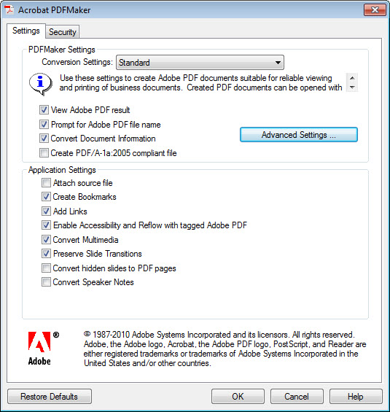
Creating PDF Files
Specify Enable Accessibility and Reflow with tagged Adobe PDF in the Preferences

Slide 64
Setting Up Your Workspace

Slide 65
Setting Up Your Workspace
Navigation Pane
Tools Panel

Slide 66
Modifying the Navigation Pane
Right-click anywhere in the Navigation Pane
Select Content from the drop-down menu
Select Order from the drop down menu
Select Tags from the drop-down menu

Slide 67
Modifying the Navigation Pane
Select View
Show/Hide
Navigation Panes
Content
Order
Tags

Slide 68
Modifying the Navigation Pane
Page Thumbnails
Content
Order
Tags

Slide 69
Modifying the Navigation Pane
Select the Options icon in the top left corner of the Tags Panel

Slide 70
Modifying the Navigation Pane
Select the Highlight Content option from the dropdown menu

Slide 71
Modifying the Tools Panel
Select the Options icon in the top right corner of the Tools Panel

Slide 72
Modifying the Tools Panel
Select the Accessibility option from the dropdown menu

Slide 73
Modifying the Tools Panel
Accessibility Panel

Slide 74
The Acrobat Accessibility Check

Slide 75
The Acrobat Accessibility Check

Slide 76
The Acrobat Accessibility Check
CAUTION:
As with all accessibility checkers, this is a TOOL for detecting issues. It does not ensure§508-compliance.

Slide 77
Inputting Document Metadata
Notes:
It’s good to supply metadata to your documents, but there are two pieces of data in particular that are required by the Acrobat Accessibility check: Title and Language.

Slide 78
Document Metadata

Slide 79
Document Metadata

Slide 80
Document Metadata

Slide 81
Working With Tags

Slide 82
What are Tags?
Acrobat Tags:
Provide assistive technologies with a representation of the document structure.
Are “hidden” – they have no physical effect on the document
Look like HTML tags, but are different

Slide 83
Adding Tags

Slide 84
Working With Tags
CAUTION!
Mistakes are permanent!
Notes:
Version control is critical when working with Acrobat tags. There is no “undo” function. Any mistake you make will be permanent, so be sure to save often.

Slide 85
Moving Tags

Slide 86
Changing Tag Properties

Slide 87
Tag Types
Paragraph Tags
Notes:
Make sure that paragraphs are grouped together rather than line-by-line.

Slide 88
Tag Types
Header Tags

Slide 89
Tag Types
Figure Tags

Slide 90
Tag Types
Table Tags

Slide 91
Tag Types
Table Tags

Slide 92
Tag Types
Link Tags

Slide 93
Tag Types
List Tags

Slide 94
Tag Types
Sublist Tags

Slide 95
The TouchUp Reading Order Tool

Slide 96
Conclusion

Slide 97
Basic Troubleshooting
Several checklists have already been developed to assist with the accessibility check process:
Section 508 Acceptance Checklist (section508.va.gov)
PDF File 508 Checklist (hhs.gov)
Refer to Handouts 5 & 6

Slide 98
Additional Resources
adobe.com/accessibility
webaim.org/techniques/acrobat/

Slide 99
Testing with JAWS ®
Lesson FOUR

Slide 100
What You Will Learn
Install the JAWS ® software demo
Use JAWS ® software to test file accessibility

Slide 101
What is JAWS ®?

Slide 102
Installing JAWS® Demo
The trial version of JAWS® can be downloaded from:
http://www.freedomscientific.com/Products/Blindness/Jaws
It allows you to run JAWS® for 40 minutes at a time. Your computer must be rebooted in order to use it for another 40 minutes.

Slide 103
Using JAWS ®
JAWS Commands FOR MS Word Navigation (gsa.gov)
JAWS Commands for PowerPoint Navigation (gsa.gov)
JAWS Commands for Internet Explorer and HTML Navigation (gsa.gov)
JAWS Commands for Excel Navigation (gsa.gov)
Refer to Handouts 7 - 10

Slide 104
Additional Resources
freedomscientific.com/

Slide 105
Capstone Exercise
Lesson FIVE

Slide 106
Summary and Review
Explain basic design considerations for creating accessible documents
Create, edit, and test accessible Microsoft® Office files
Create, edit, and test accessible .pdf files
Use JAWS ® software to test file accessibility

